Slide 1

Educational Research: Planning, Conducting, and Evaluating Quantitative and Qualitative Research
Sixth Edition
Chapter 7
Collecting Qualitative Data
Copyright © 2019, 2015, 2012 Pearson Education, Inc. All Rights Reserved
Notes:
If this PowerPoint presentation contains mathematical equations, you may need to check that your computer has the following installed:
1) MathType Plugin
2) Math Player (free versions available)
3) NVDA Reader (free versions available)

Slide 2
What Are the Five Process Steps in Qualitative Data Collection? (1 of 2)
Identify participants and sites
Gain access to individuals and sites
Identify what types of information will answer your research questions
Design protocols or instruments for collecting and recording information
Administer the data collection

Slide 3
What Are the Five Process Steps in Qualitative Data Collection? (2 of 2)
Qualitative researchers identify participants and sites through purposeful sampling.
Qualitative studies are usually conducted at the research site.
Qualitative studies rely on general interviews or observations not others’ instruments.
Qualitative researchers record information through self-designed protocols.
Qualitative studies require sensitivity to challenges and ethical issues from gathering face-to-face information, often in homes and workplaces.

Slide 4
What Are the Different Purposeful Sampling Approaches for Selecting Participants and Sites
Intent is not to generalize to a population, but to develop an in-depth exploration of a central phenomenon
Quantitative focus is probability
Qualitative focus is the best understanding

Slide 5
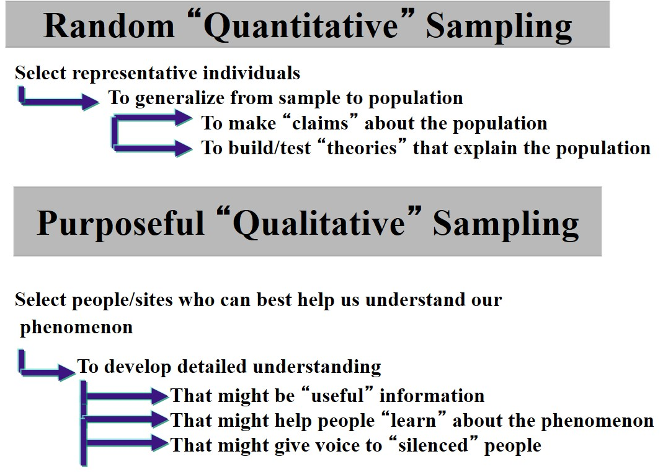
Figure 7.1 Difference between Probability Sampling and Purposeful Sampling

Slide 6
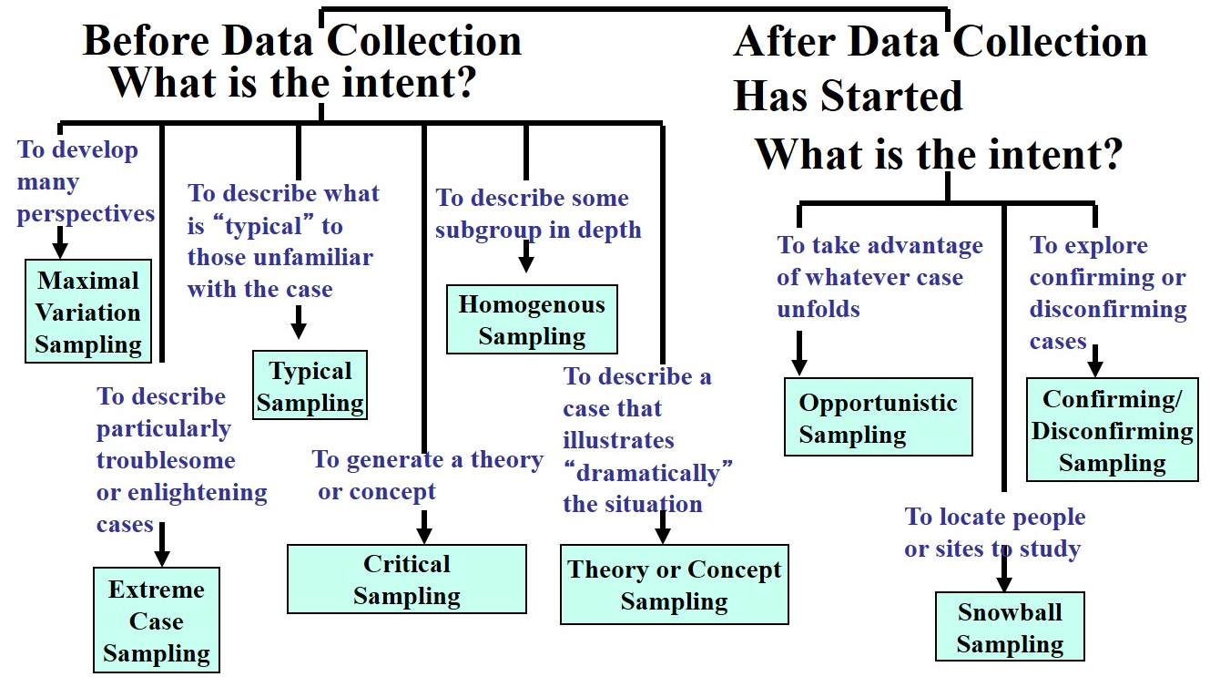
Figure 7.2 Types of Purposeful Sampling

Slide 7
What Types of Qualitative Data Will You Collect?
Observations
Interviews and questionnaires
Documents
Audiovisual materials

Slide 8
Table 7.1 Forms of Qualitative Data Collection
Forms of Data Collection | Type of Data | Definition of Type of Data
Observations | Field notes and drawings | Unstructured text data and pictures taken during observations by the researcher
Interviews and questionnaires | Transcriptions of open-ended interviews or open-ended questions on questionnaires | Unstructured text data obtained from transcribing audio recordings of interviews or by transcribing open-ended responses to questions on questionnaires
Documents | Hand-recorded notes about documents or optically scanned documents | Public (e.g., notes from meetings) and private (e.g., journals) records available to the researcher
Audiovisual materials | Pictures, photographs, video recording, objects, and sounds | Audiovisual materials consisting of images or sounds of people or places recorded by the researcher or someone else

Slide 9
Figure 7.5 Observational Checklist
Fill in the blank Did you gain permission to study the site? | Fill in the blank Will you develop rapport with individuals at the site?
Fill in the blank Do you know your role as an observer? | Fill in the blank Will your observations change from broad to narrow?
Fill in the blank Do you have a means for recording field notes, such as an observational protocol? | Fill in the blank Will you take limited notes at first?
Fill in the blank Do you know what you will observe first? | Fill in the blank Will you take both descriptive as well as reflective notes?
Fill in the blank Will you enter and leave the site slowly, so as not to disturb the setting? | Fill in the blank Will you describe in complete sentences so that you have detailed field notes?
Fill in the blank Will you make multiple observations over time? | Fill in the blank Did you thank your participants at the site?

Slide 10
What Types of Qualitative Data Will You Collect?
Interviews: Types of Interviews and Open-Ended Questions on Questionnaires
Types: One-on-one, focus group, phone, web-based video, e-mail
General open-ended questions that are asked allow the participant to:
  Create options for responding
  Voice their experiences and perspectives
Information is recorded, then transcribed for analysis

Slide 11
Figure 7.6 Checklist for Interviewing
Fill in the blank Who will participate in your interviews?
Fill in the blank What types of interviews are best to conduct?
Fill in the blank Is the setting for your interview comfortable and quiet?
Fill in the blank If you are audiotaping, have you prepared and tested the equipment?
Fill in the blank Did you obtain consent from the participants to participate in the interview?
Fill in the blank Did you listen more and talk less during the interview?
Fill in the blank Did you probe during the interview? (ask to clarify and elaborate)
Fill in the blank Did you avoid leading questions and ask open-ended questions?
Fill in the blank Did you keep participants focused and ask for concrete details?
Fill in the blank Did you withhold judgments and refrain from debating with participants about their views?
Fill in the blank Did you withhold offering advice and suggestions and focus on the task of gathering participant views?
Fill in the blank Were you courteous and did you thank the participants after concluding the interview?

Slide 12
What Field and Ethical Issues Need to Be Anticipated?
Field Issues
Sufficient access to the site for data collection
  Sufficient time for data collection
  Limit initial collection to one or two observations or interviews
  Time is needed to establish a substantial database
Observational role
Building rapport with participants
Obtaining permission to use documents and audiovisual materials

Slide 13
What Field and Ethical Issues Need to Be Anticipated?
Ethical Issues
Informing participants of purpose
Refraining from deceptive practices
Sharing your role as researcher
Being respectful of the research site
Giving back or reciprocity
Using ethical interview practices
Maintaining confidentiality
Collaborating with participants

Slide 14
Educational Research: Planning, Conducting, and Evaluating Quantitative and Qualitative Research
Sixth Edition
Chapter 8
Analyzing and Interpreting Qualitative Data
Copyright © 2019, 2015, 2012 Pearson Education, Inc. All Rights Reserved
Notes:
If this PowerPoint presentation contains mathematical equations, you may need to check that your computer has the following installed:
1) MathType Plugin
2) Math Player (free versions available)
3) NVDA Reader (free versions available)

Slide 15
What Are the Six Steps in Analyzing and Interpreting Qualitative Data?
Preparing and organizing the data for analysis
Exploring the data through coding
Using codes to develop description and themes
Representing the findings through narratives and visuals
Making an interpretation of the meaning of the findings
Using strategies to validate the accuracy of the findings

Slide 16
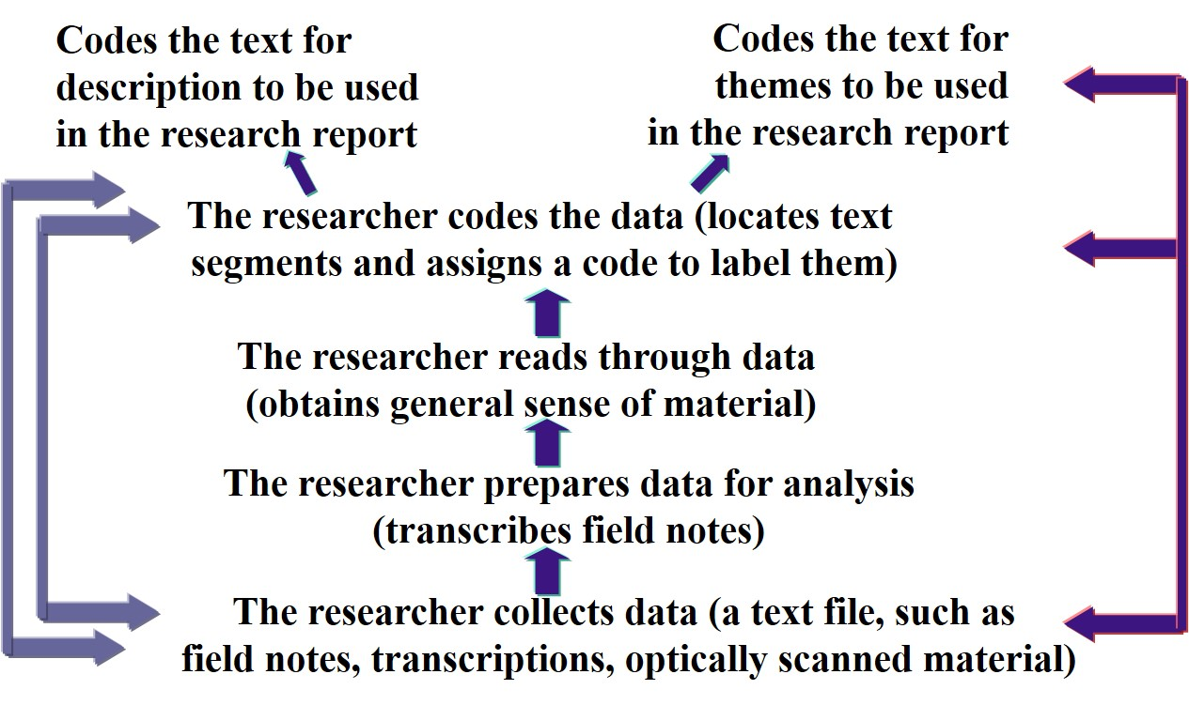
Figure 8.1 The Qualitative Process of Data Analysis

Slide 17
How Do You Prepare and Organize the Data for Analysis?
Organize Data
Develop a matrix or table of sources that can be used to organize the material
Organize material by type (all interviews, all documents, etc.)
Keep duplicate copies of materials
Transcribe data
Prepare data for hand or computer analysis (and select computer program)

Slide 18
How Do You Prepare and Organize the Data for Analysis?
Transcribe Data
Transcription is the process of converting audio recordings or field notes into text data
Consider software, a professional transcriptionist, or transcribe yourself word-for-word
Approximately 4 hours to transcribe 1 hour of audio

Slide 19
How Do You Prepare and Organize the Data for Analysis?
Analyze by Hand or Computer
Hand analysis of qualitative data: researchers read the data, mark it by hand, and divide it into parts
Hand analysis if you
  Prefer not to use software
  Want to be close to the data
  Have the time

Slide 20
How Do You Prepare and Organize the Data for Analysis?
Use of Qualitative Data Analysis Software Programs: Procedures for Using Qualitative Data Analysis Software
Organize your files
Select a program
Import the file into the software
Mark sentences that pertain
Code the blocked text
Search for text matching each code
Collapse codes into broad themes

Slide 21
How Do You Prepare and Organize the Data for Analysis?
Use of Qualitative Data Analysis Software Programs: Specific Programs Available
ATLAS.t i(Mac and Windows)
Dedoose (cloud-based)
Hyper RESEARCH (Mac and Windows)
MAX Q D A (Mac and Windows)
Nvivo (Mac and Windows)

Slide 22
How Do You Explore and Code the Data?
Code the Data
Read through all transcripts
Start with one document
Ask, “What is this person saying?”
Identify text segments
Assign a code
  One, two, or three words that describe what is being said
  When possible use a participant’s actual words (in vivo code)
  Terms from the literature can be used
  Practice lean coding (e.g., 10-15 codes for 20 p g transcript)

Slide 23
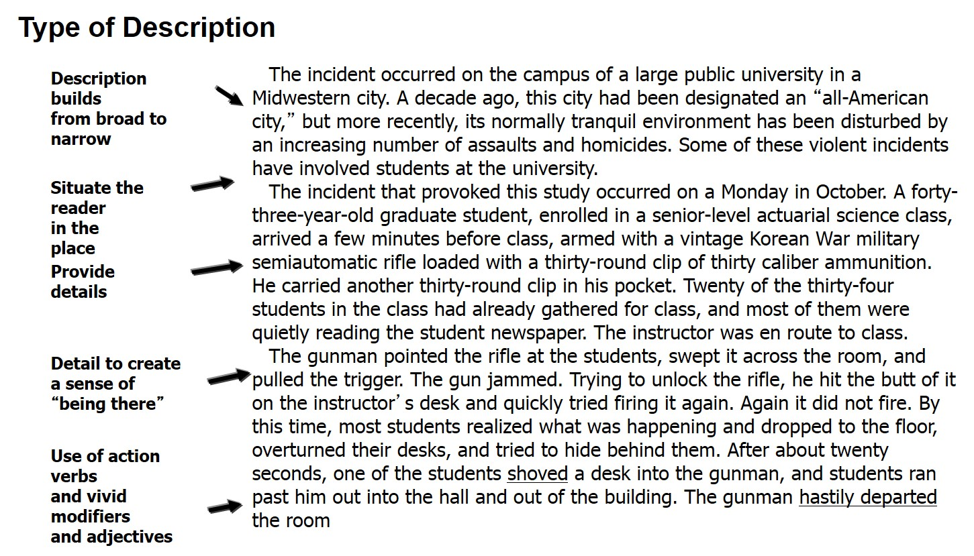
Figure 8.5 Hand-Coding a Page from a Sample Interview Transcript

Slide 24
How Do You Represent and Report Findings?
Representing Findings
Comparison table: A table used to compare groups on one theme
Hierarchical tree: A diagram that visually represents themes and their interconnections
Figures/diagrams: A visual depiction that shows the connections between themes
Drawings: Maps of the physical layout of the site
Demographic table: A table of demographics on individual participants or research site

Slide 25
How Do You Represent and Report Findings?
Reporting Findings
Multiple perspectives and contrary evidence
Metaphors and analogies
Report quotes from interviews
Write in detail
Tensions and contradictions
Include a dialogue to support themes

Slide 26
How Do You Interpret Findings?
Summarize the findings
Include personal reflections about the meaning of the data
Compare findings with the literature, perhaps including personal views
Address limitations of the study
Make suggestions for future research

Slide 27
How Do You Validate the Accuracy of Your Findings?
Validating findings: researcher determines the accuracy or credibility of the findings
Triangulation: Using corroborating evidence
Member checking: Asking members to check the accuracy of the account
External audit: Hiring the services of an individual outside the study to review the study

Slide 28
Educational Research: Planning, Conducting, and Evaluating Quantitative and Qualitative Research
Sixth Edition
Chapter 9
Reporting and Evaluating Research
Copyright © 2019, 2015, 2012 Pearson Education, Inc. All Rights Reserved
Notes:
If this PowerPoint presentation contains mathematical equations, you may need to check that your computer has the following installed:
1) MathType Plugin
2) Math Player (free versions available)
3) NVDA Reader (free versions available)

Slide 29
What is a Research Report, and What Are Its Types? (1 of 11)
A research report is a completed study that reports an investigation or exploration of a problem, identifies questions to be addressed, and includes data collected, analyzed, and interpreted by the researcher.

Slide 30
What is a Research Report, and What Are Its Types? (3 of 11)
What Are the Types of Research Reports?
Dissertations and theses
Dissertation and thesis proposals
Journal articles
Conference papers
Conference proposals
Reports for policy makers or school leaders and personnel

Slide 31
How Should You Structure Your Report? (1 of 4)
Look at the Physical Structure of Research Reports
Examine:
  The levels of heading in a study
  The six steps in the research process
  The research questions or hypotheses and the answers
  The structures or different types of reports, qualitative and quantitative

Slide 32
How Should You Structure Your Report? (2 of 4)
Design an Appropriate Quantitative Structure
Front Matter
Title page
Abstract
Body of the Paper
Introduction
Review of the literature
Methods
Results
Discussion
Back Matter
References
Appendices

Slide 33
How Should You Structure Your Report? (3 of 4)
Design an Appropriate Qualitative Structure
A scientific structure:
Front Matter
Title page
Preface and acknowledgements (opt.)
Table of contents, tables, figures (opt.)
Abstract
Body of the Paper
Introduction
Procedures
Findings
Discussion
Back Matter
References
Appendices (figures, interviews, observational protocols)

Slide 34
How Should You Structure Your Report? (4 of 4)
Design an Appropriate Qualitative Structure
Scientific approach
Storytelling approach
Thematic approach
Descriptive approach
Theoretical approach
Experimental, alternative, or performance approach

Slide 35
How Do You Write in a Sensitive, Ethical, and Scholarly Way?
Are sensitive to individuals and use language that reduces bias
Use appropriate research terms
Write and report the findings ethically
Employ a point of view consistent with quantitative and qualitative approaches
Balance research and content
Interconnect parts of a study
Advance a concise title

